Slide 1
Not Your Average Letter, Stand Out with the TED-C Design
Pricing & Classification Service Center (PCSC)
July 2023

Slide 2
Who or What is TED-C?
TED-C ≠ Ted Cruz or Ted Cassidy or Ted Chiang
TED-C = Trailing Edge Die-Cut
TED-C mailpieces are letter-size pieces that have a die-cut that extends past the conventional trailing edge of the mailpiece.
The USPS and the mailing industry collaborated to create requirements that will allow for the mailing of non-rectangular TED-C letter-size mailpieces at automation letter prices.
Notes:
Ted Cruz – Texas Senator Ted Cassidy – Played Lurch (the original Addams Family butler) You rang? Ted Chiang – Award winning Sci-Fi writer

Slide 3
TED-C Physical Standards
Non-rectangular TED-C mailpieces must meet the following dimensional criteria as determined by USPS Engineering Tests to qualify for automation letter prices:
Height: 3 ½ inches (min) to 6 1/8 inches (max)
Length: 5 inches (min) to 10 ½ inches (max)
Thickness: 0.009 inch (min) to 0.25 inch (max)
Aspect Ratio: 1.3 (min) to 2.5 (max)
Max Piece Weight: 2.5 ounces
NOTE:
Yellow highlights indicate differences in dimensional criteria from typical enveloped and card type automation letters.
When measuring for minimum length and minimum aspect ratio, you cannot include the die-cut design. For example, if the piece is 4 ½” in length without the die-cut, and with the die-cut design allows the piece to meet the 5” minimum length, the piece is non-mailable (i.e., the die-cut design must not be used to meet the minimum length of 5”;the minimum length must measure 5” without the die-cut design).
When measuring for maximum length and maximum aspect ratio, the die-cut design must be included. (i.e., if the piece is 10 1/8” without the die-cut and the die-cut design makes the piece exceed the 10 ½” maximum, the piece is not eligible for automation letter prices).
Notes:
Note the modified maximum length = 10.5” (not 11.5”) Note the modified maximum weight = 2.5 oz. (not 3.5 oz.) When measuring for minimum length and aspect ratio, do NOT include the die-cut design. When measuring for maximum length and aspect ratio INCLUDE the die-cut design.
Nonmachinable if over 10.5”

Slide 4
Additional TED-C Requirements
Mailpiece must maintain four 90-degree corners
Die-cut must be only on the trailing (left) edge
Die-cut cannot extend more than 5/8” from the conventional trailing (left) edge
Die-cut design must start at a minimum of 5/16” from both the top and bottom edges
Die-cut must vertically cover, at a minimum, more than 1” of space
Die-cut cannot extend, on the TED-C template, only into Zone “A” or only into Zone “D” or only into both Zones “A” & ‘D” (i.e., die-cut must have some part of the extension in Zones “B” or “C”)
Must be in a sealed envelope or sealed along all open edges or be a single card
All envelopes must be made of paper with a minimum 50 pounds paper basis weight (Book grade) or equivalent. (See DMM 201.3.2)
Window envelopes must meet DMM 601.6.3 and ensure there is at least ½ inch between the bottom edge of the window and bottom edge of the envelope and must have a clearance of 5/8” between the left edge of the window and the conventional trailing edge of the mailpiece.
Must be included in an Intelligent Mail barcoded (IMb) Full-Service mailing and have an address block barcode
Residual pieces will be charged at the applicable residual prices
The die-cut shape must be integral to the mailpiece and not be an attached extension.
The die-cut shape must extend away from (further left of) the conventional trailing edge. No portion of the die-cut may extend into the mailpiece (right of the conventional trailing edge).
Notes:
Review requirements No FSMs

Slide 5
Ineligible for TED-C
A TED-C mailing is not eligible for automation letter-size prices if it is or includes any of the following:
First-Class Mail Single-Piece prices
Postcard prices
Folded self-mailers
Booklet mailpieces
Flat-size mailpieces
Secure Destruction (Under review)
Approval:
Pre-approval is not required. (DMM 201.3.3)
TED-C pieces are only authorized for Full-Service automation prices.
Pieces presented for mailing not meeting the TED-C requirements will be charged nonmachinable pricing.
While not required, if you would like your TED-C design reviewed, please contact a Mailpiece Design Analyst (MDA) at MDA@usps.gov.
TED-C
Notes:
Review Ineligible products
Secure Destruction – currently under review.
Secure Destruction is a cost effective, secure, and convenient way to manage mail with personal protected information.
Part of the USPS® BlueEarth sustainability initiatives and an opt-in service, this new program securely shreds and recycles letter and flat-sized pieces of Undeliverable-As-Addressed (UAA) First-Class Mail® with personal protected information that would otherwise be returned to the sender (RTS).
Mailers participating in OneCode ACS®, Full-Service ACS, or Traditional ACS™ with an Intelligent Mail® barcode may request Secure Destruction Service using a Secure Destruction Service Type ID (STID).
Participation offers mailers reduced costs associated with receiving, handling, and destroying RTS mail with Privacy Protected Information (PPI). USPS also benefits by reducing the amount of Return to Sender (RTS) mail that needs to be processed, transported, and delivered to mailers.

Slide 6
Letter Mail TED-C Inspection Template Instructions
Notes:
The letter template is a two-page document
The first page includes information pertaining to the Zones on the template. The Zones represent the sensors on the machines, or where the lights are placed. The machines are timed by the images to determine the start and end of the mailpiece.
The template explains the Zones where the die-cut extension can fall and where it cannot.
If the customer subscribed to Informed Delivery and if the die-cut extension does not fall into Zone C, then the customer will not see the full image of the mailpiece, They will only get a rectangular image of their mailpiece. If the die-cut is not in Zone C, it does not mean the piece is disqualified from automation, it only means that they will not see the image in their email in Informed Delivery. Important Note: If the Die-Cut extension's leftmost edge is not in ZONE C, it will process. However, there may not be any visibility of the Die-Cut in Informed Delivery® for recipients.
The vertical height of the die-cut must be greater than one inch

Slide 7
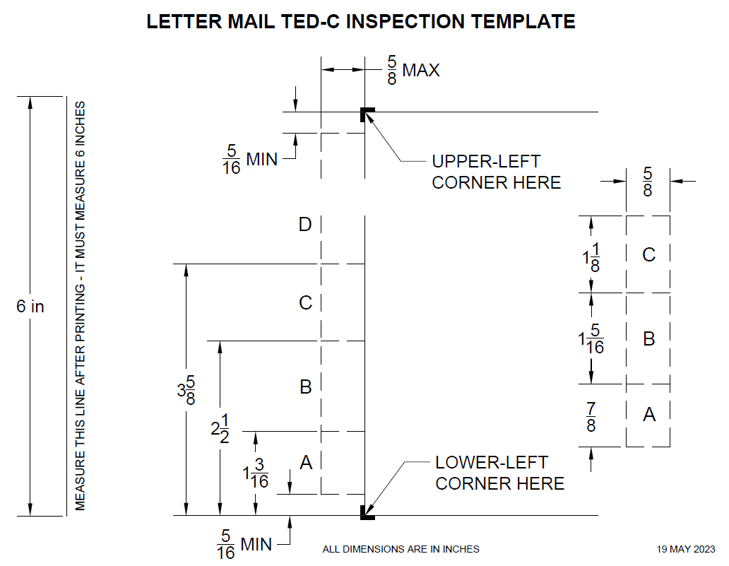
Letter Mail TED-C Inspection Template Image – 6” Ruler
Notes:
This is the template that must be printed. There is a 6” ruler on the left to verify that when printed, it was printed correctly. On your printer make sure you “print to scale” or “actual size.” Take a ruler and measure the 6” line to confirm you printed to scale or actual size
Place the lower left corner of the mailpiece within the lower left corner of the bold area (see arrow).
There must be a clearance of 5/16” from the bottom left corner of the mailpiece to the bottom left corner of the die-cut.
There must be 5/8” max. extension from the left (trailing) edge.
The vertical size of the die-cut must be greater than 1”
Some part of the die-cut extends into either Zone B or Zone C
Place the top left corner of the mailpiece to the top left corner of the bold area on the template.
There must be a clearance of 5/16” from the top left corner of the mailpiece to the top left corner of the die-cut.
The die-cut extension should not extend beyond that vertical dotted line. That line is the maximum width the die-cut can extend
It is good to note that the mailpiece must maintain four rectangular corners

Slide 8
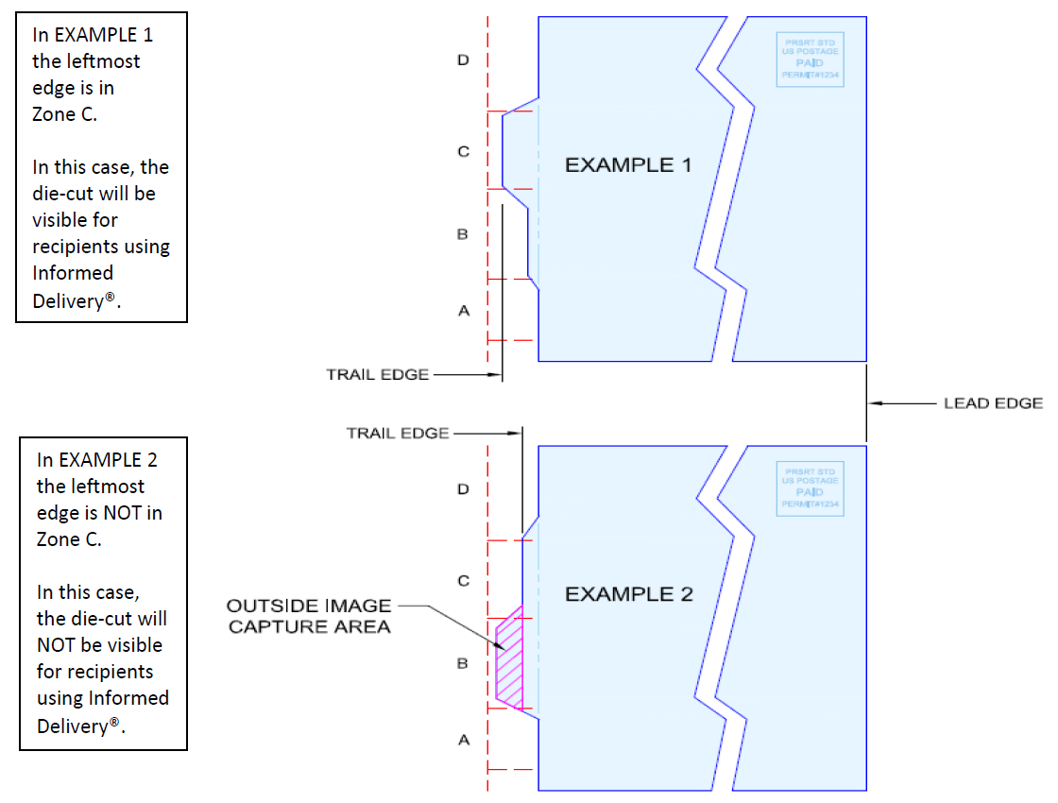
TED-C Mailpieces & Informed Delivery®
Notes:
Explain why the TED-C in Example 1 will be seen by Informed Delivery users, and why the TED-C in Example 2 will NOT be visible to Informed Delivery users.

Slide 9
TED-C Designs
Notes:
The texture of the road feels like sandpaper. This was tested and passed for automation compatibility. Even though the die-cut design is acceptable, the overall mailpiece must still meet automaton compatibility requirements.

Slide 10
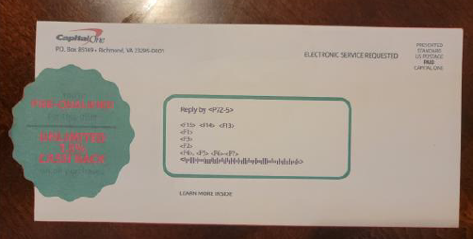
TED-C Designs
As a result of USPS Engineering tests, TED-C pieces are now eligible to utilize Ancillary Service Endorsements (ASE) on the mailpiece. Please reference Domestic Mail Manual 202.4.3 for ASE placement information.
This has a scallop edge; It also bears an Ancillary Service Endorsement
Notes:
TED-C pieces are now eligible to have an ancillary service endorsement because pieces that are endorsed are sent to PARS (Postal Address Redress System). USPS Engineering tests have confirmed the PARS machines are now able to process these pieces. FCM pieces are normally forwarded if there is a change of address on file.
The Move Update standard requires mailers to utilize ONE approved method to update the addresses within 95 days prior to the postage statement finalization date. Therefore, using ACS on a piece does not qualify that piece for meeting the Move Update requirement, but qualifies additional pieces mailed within the subsequent 95 days.

Slide 11
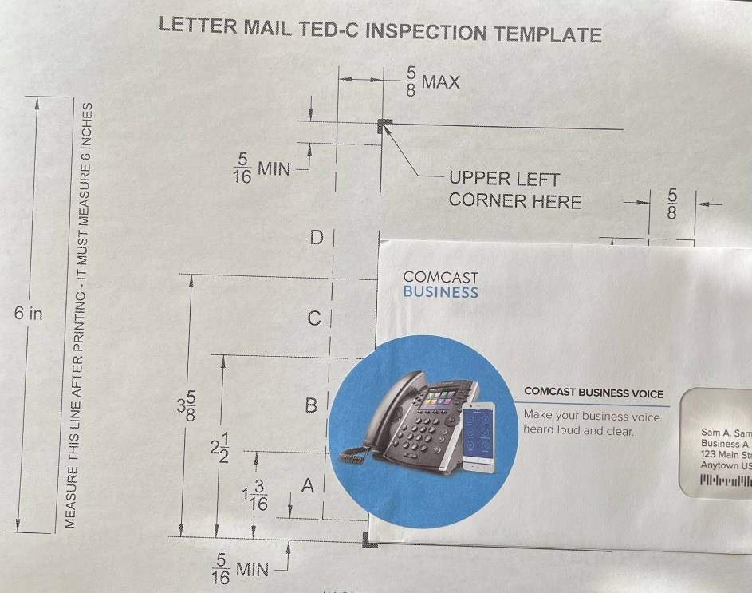
TED-C Overlayed on Template
Notes:
Here is a sample overlayed on the Template. You will notice the die-cut extension falls into Zones A and B, which is eligible for automation. You will notice it does not fall into Zone C. This means that if the recipient had Informed Delivery, they would not see the full image of the design. They will only see a rectangular image.
You will also notice the die-cut extension does not go pass the dotted line.
You will also notice the vertical height of the design is greater than 1 inch.
You will also notice the die-cut has at least 5/16” clearance from the bottom edge.

Slide 12
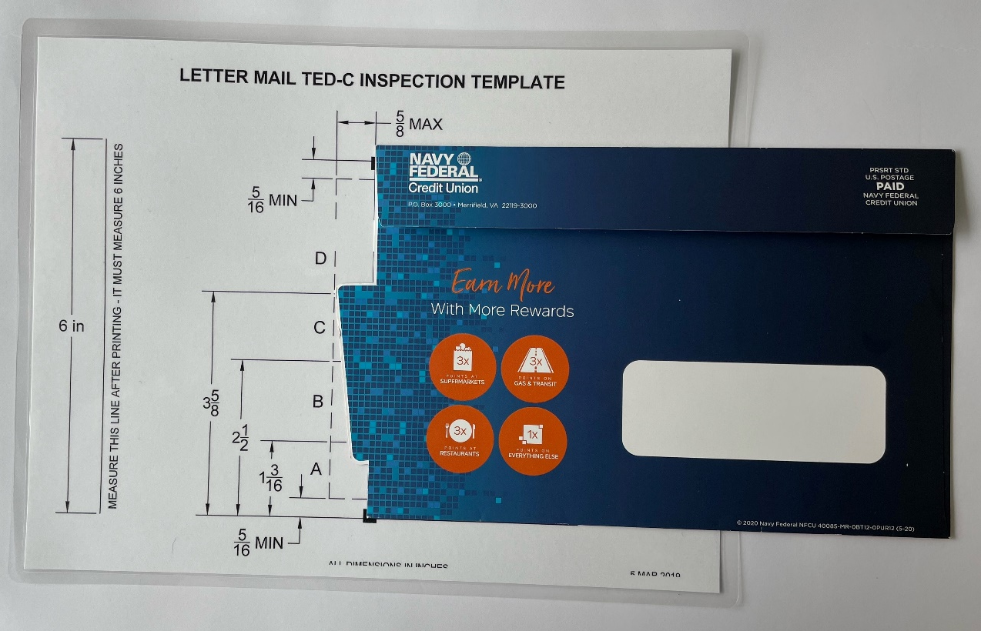
TED-C Overlayed on Template
Notes:
Here is a sample overlayed on the Template. You will notice the die-cut extension falls into Zones A and B, which is eligible for automation. You will notice it falls into Zone C. This means that if the recipient had Informed Delivery, they WOULD see the full image of the design.
You will also notice the die-cut extension does not go pass the dotted line. (5/8”)
You will also notice the vertical height of the design is greater than 1 inch
You will also notice the die-cut has at least 5/16” clearance from the bottom edge

Slide 13
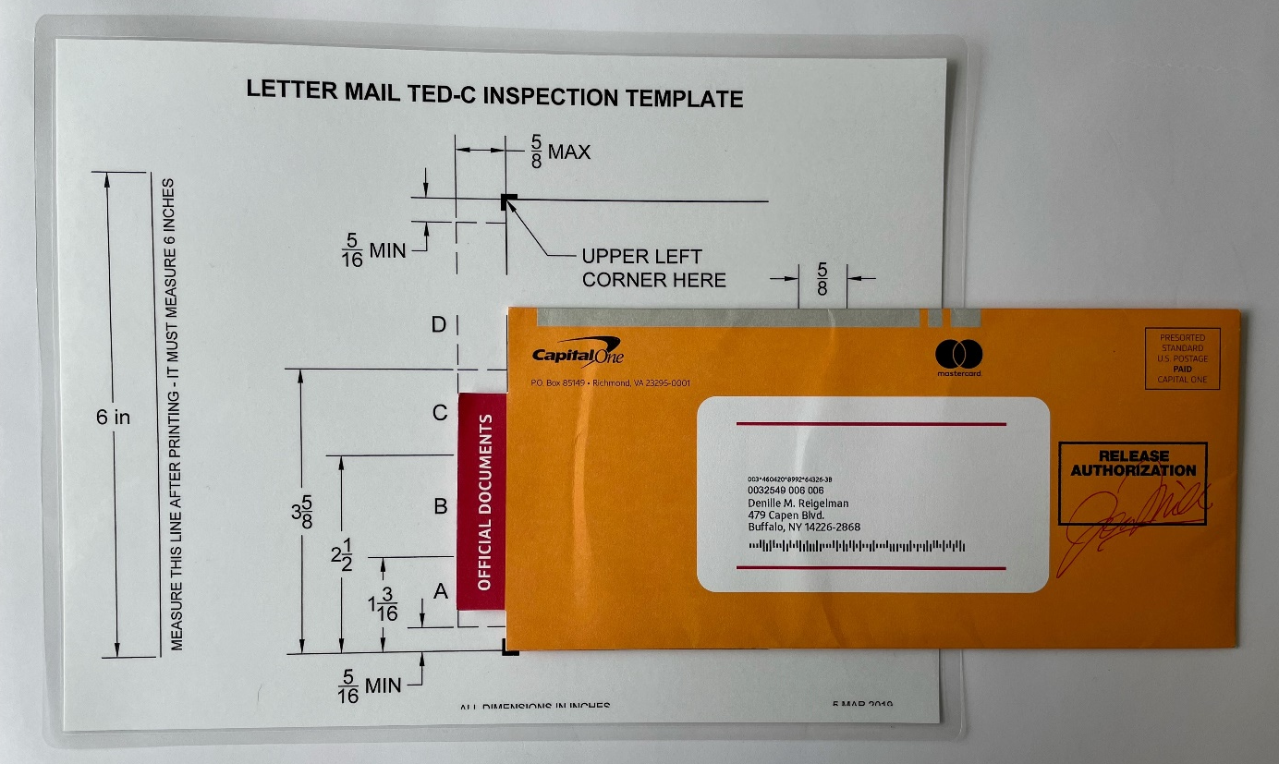
TED-C Overlayed on Template
Notes:
Here is a sample overlayed on the Template. You will notice the die-cut extension falls into Zones A and B, which is eligible for automation. You will notice it falls into Zone C. This means that if the recipient had Informed Delivery, they WOULD see the full image of the design.
You will also notice the die-cut extension does not go pass the dotted line. (5/8”)
You will also notice the vertical height of the design is greater than 1 inch
You will also notice the die-cut has at least 5/16” clearance from the bottom edge

Slide 14
Trailing Edge Die-Cut Process Update
Effective February 1, 2023: Pricing & Classification Service Center (PCSC) approval no longer required
Contact a Mailpiece Design Analyst (MDA) for design review as needed (MDA@usps.gov)
Communication via Industry Alert week of January 22nd (updated March 3rd)
https://postalpro.usps.com/node/11906
TED-C Resources:
Postal Pro: Type in the search box “TED-C”
The first link will be the Letter Mail TED-C Template (https://postalpro.usps.com/alternative_designs/ted_c_template)
The second link will be the TED-C Process for Eligibility (https://postalpro.usps.com/alternative_designs/ted_c_process)
Domestic Mail Manual 201.3.3
MDA@usps.gov for design review if needed

Slide 15
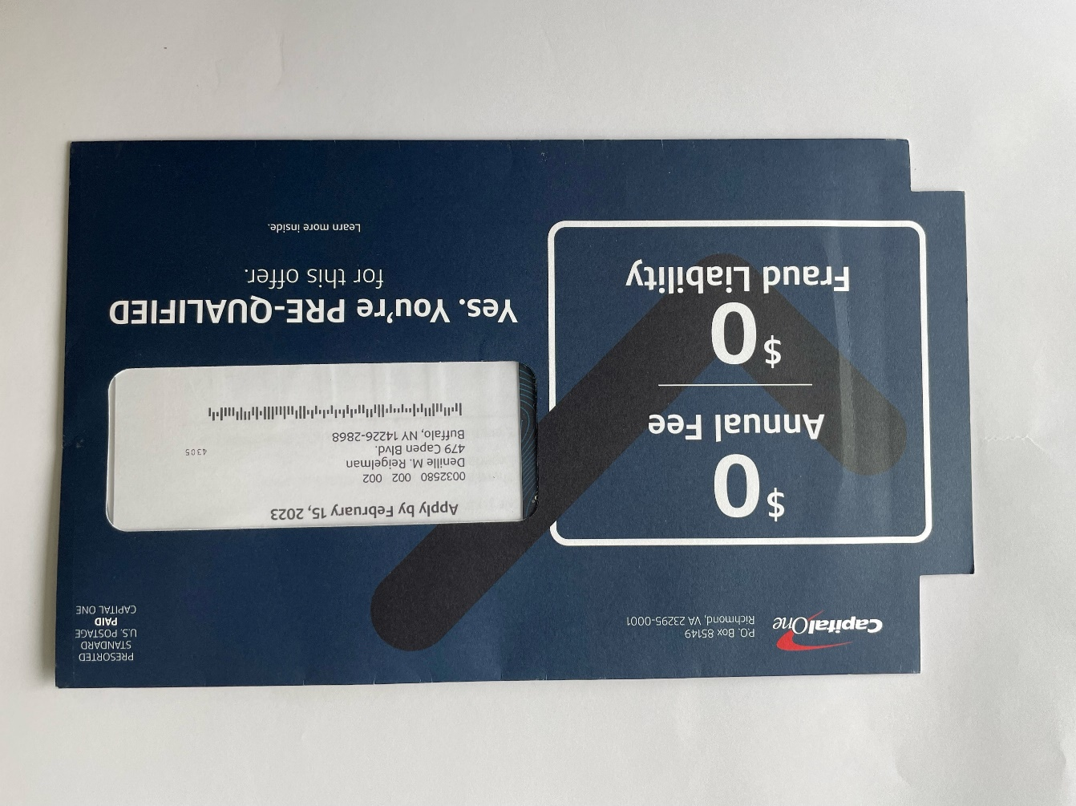
Questions?
Notes:
Questions?

